Slide 1
Exploring the Non-Fungible Token Revolution:
An Analysis of NFT Transactions
DCU, CA687I - Assignment 1 (Big Data Cloud)
Group A
Vinit Saini, Student ID - 21267544
Marcio Vieira, Student ID - 22266459
Krystian Fikert, Student ID - 22268291
Notes:
Welcome to the amazing world of Non-Fungible tokens (NFT)
NFT are digital assets that offer great opportunities and potential for applications that will disrupt how the we think about assets ownership.
The project aims to investigate the NFT revolution examining the transactions and trades, to identify financial and quantitative patterns.

Slide 2
Project Scope
Analyzing NFT Collections
NFT Transactions and Trades.
Explore Market Metrics.
View of Buyers and Sellers
Explore Big Data Technologies
Notes:
The NFT Market was estimated in more than 15 billion dollars in 2021 and the marketing is in a continuous expansion.
Our analysis aims to uncover valuable insights into the NFT market and inspire others to participate in NFT movement.
The project scope involves analyzing the transactions and trades of NFTs collections occurred between 2021 and 2023. The aim is to identify financial quantitative patterns and gain insights of the NFT dynamics.
The project involves analyze of datasets acquired from different sources Kaggle and Moralis API.

Slide 3


Dataset
8 GB, General NFTs related attributes
137 GB NFT Contract and Transactions data.
110 GB, NFT Contracts metadata
27 GB, NFT Transactions i.e Buyers, sellers…
Notes:
We utilized Kaggle dataset for our initial analysis where we found a lack of data.
For the additional data we had to connect with Moralis API and fetch the data.
We also tried to connect direct with Open Sea but even after many emails we never got any response back.

Slide 4
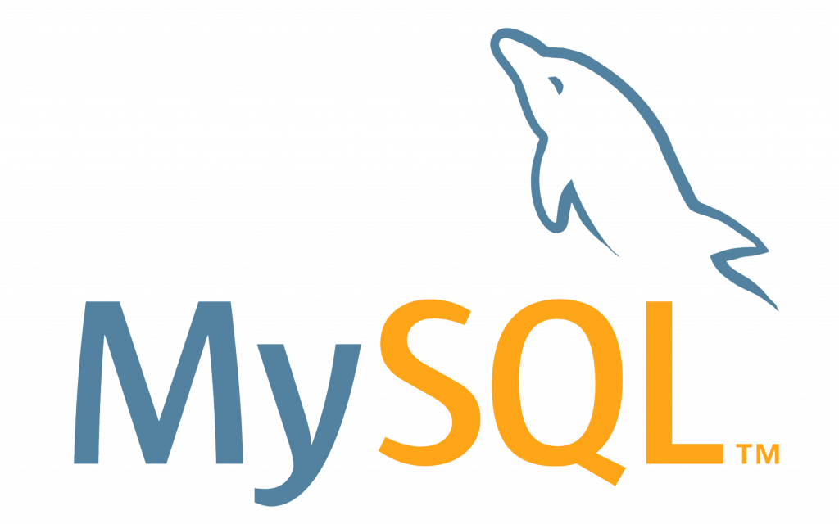

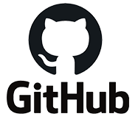
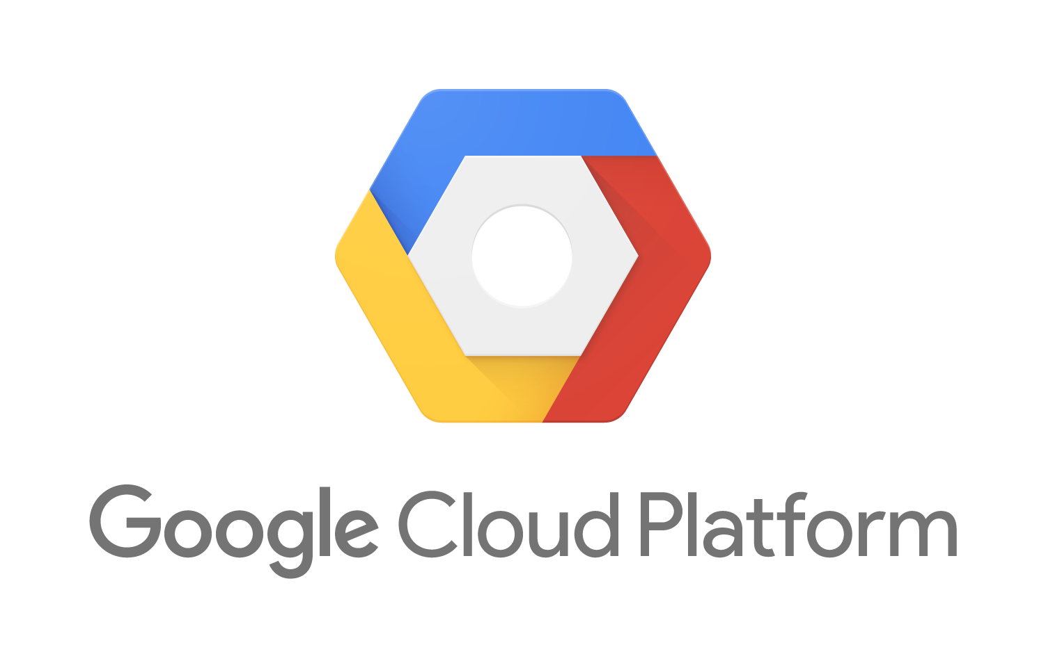
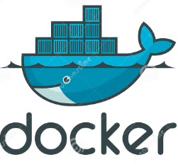
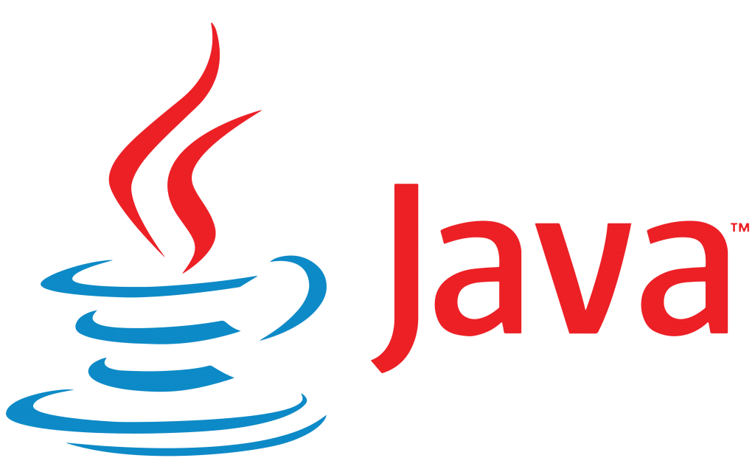
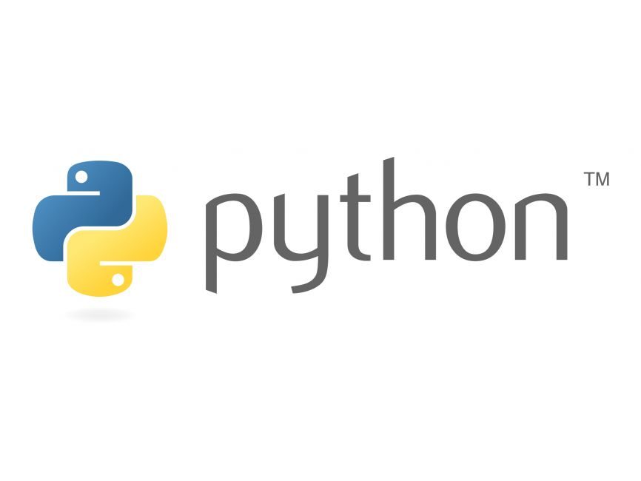
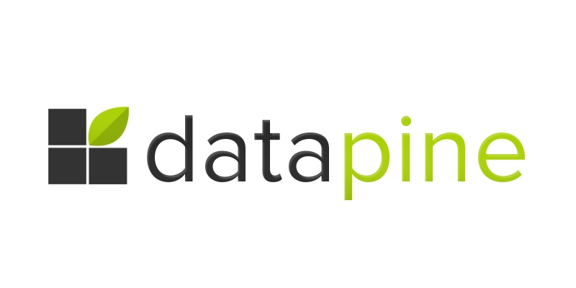


Technologies and Tools
Notes:
We have used different technologies aiming to extract its best used.
Python was utilized for reading, parsing and transforming the data from various sources.
Apache spark was used to process and analyze the large dataset, where the nature of distributed computing enable the analysis of the data.
Google Cloud - We use google cloud to host the python scripts and to process the data utilizing DataProc and Mysql to store the data for its analysis.
Datapine was utilized as the presentation layer consuming the data from MySql database that was previously processed by Apache Spark.
We used Java for the Spark implementation and we tried to use Tableau and Qlik for the data presentation but later we found Datapine compelling enough for our use-cases.

Slide 5

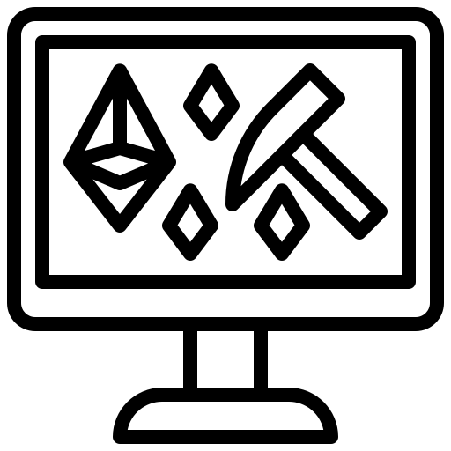
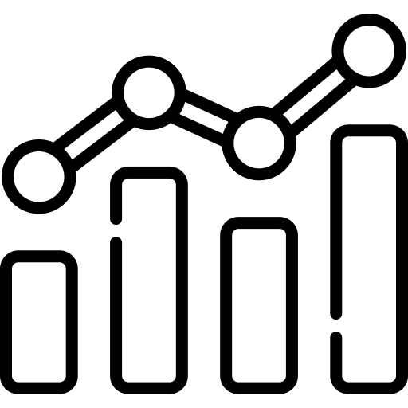
Metrics
NFT Collection Metrics Number of NFTs Number of Trades Min / Max trade value Average Value
Minters Metrics Number of NFTs minted by Minter Valuation of a Minter Market Valuation
Traders Metrics Top buyers Top Sellers Top Traders
Notes:
The project involves analyses of many metrics from NFT Collections, Minters and Traders metrics
We acquired the insights of top performing NFT Collections its buyers and sellers
Prefered type of contracts
Minters Trading volume
Average transaction values.

Slide 6
Demo
https://public.datapine.com/#board/DdnJRJhEPSDXA82siA30Pg
Notes:
The project involves analyses of many metrics from NFT Collections, Minters and Traders metrics
We acquired the insights of top performing NFT Collections its buyers and sellers
Prefered type of contracts
Minters Trading volume
Average transaction values.

Slide 7
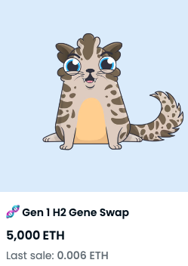
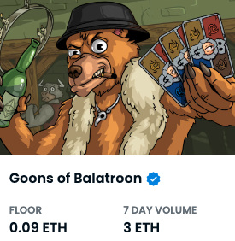
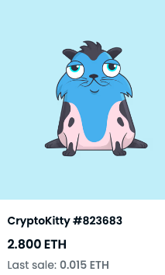
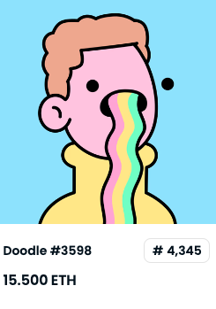
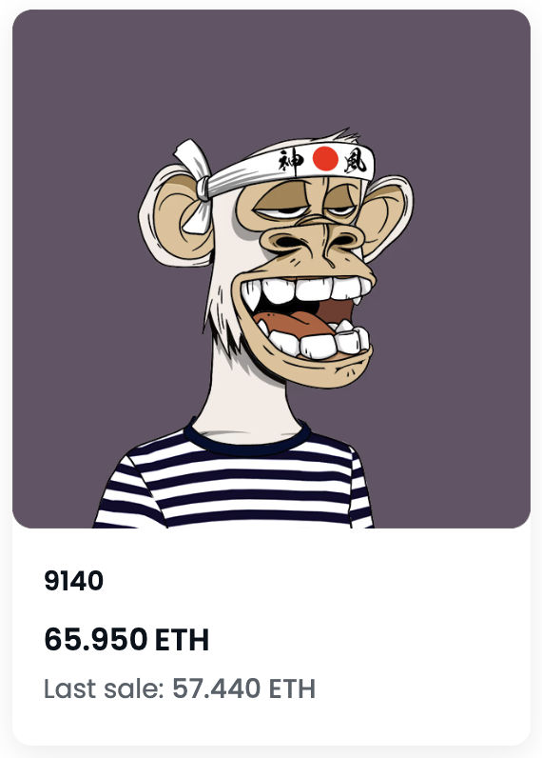

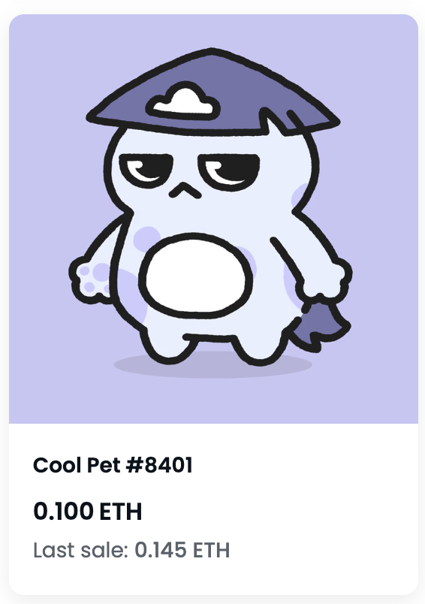
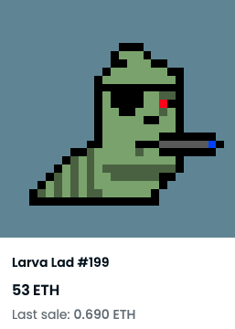
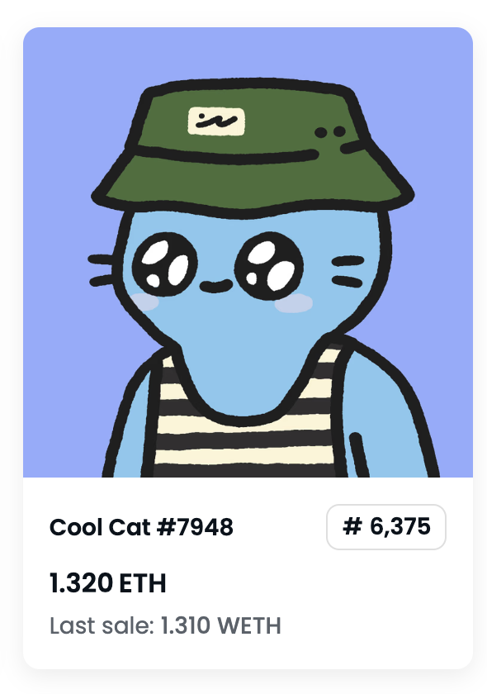
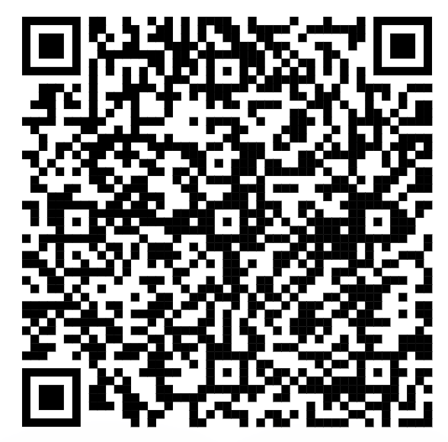

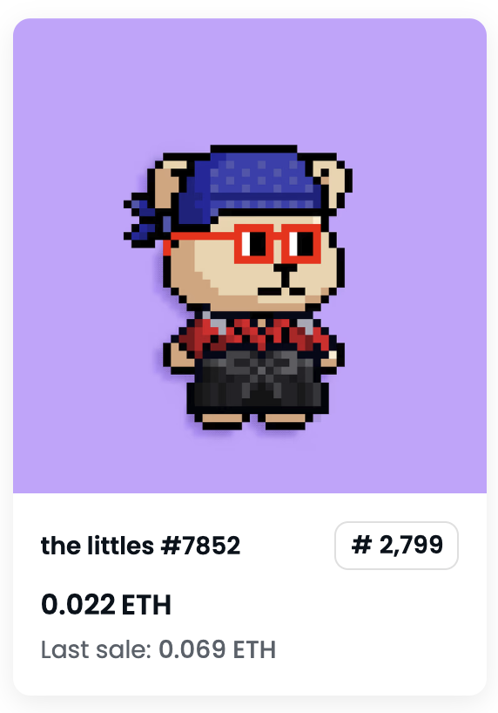
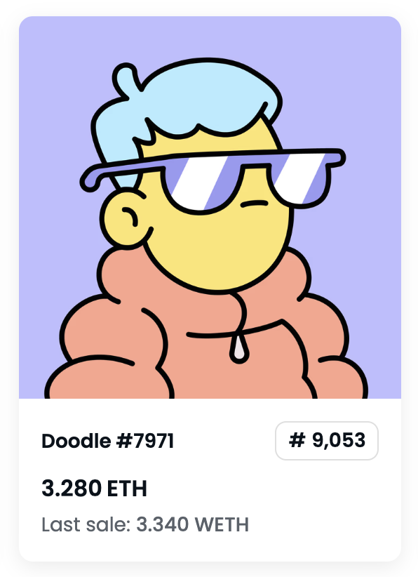
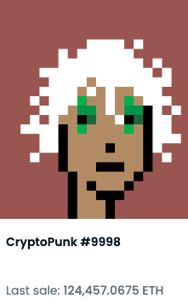

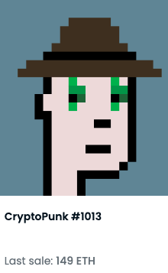
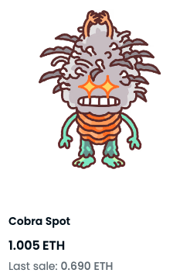
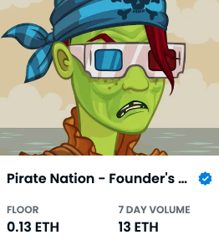
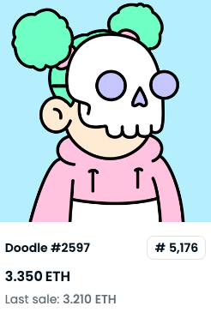
Thank you

